Slide 1
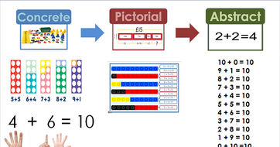
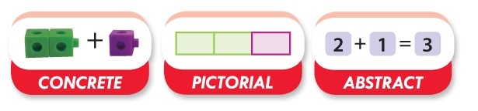
Maths – No Problem!
Parent Workshop

Slide 2

Aims of the session
Curriculum overview
Why Maths - No Problem
What Maths - No Problem is
Mastery approach to mathematics
Overview of Maths - No Problem
How you can help at home
A typical maths lesson at Heckington

Slide 3
Aims of the National Curriculum 2014
The national curriculum for mathematics aims to ensure that all pupils:
Become fluent in the fundamentals of mathematics, including through varied and frequent practice with increasingly complex problems over time, so that pupils develop conceptual understanding and the ability to recall and apply knowledge rapidly and accurately.
Reason mathematically by following a line of enquiry, conjecturing relationships and generalisations, and developing an argument, justification or proof using mathematical language.
Can solve problems by applying their mathematics to a variety of routine and non routine problems with increasing sophistication, including breaking down problems into a series of simpler steps and persevering in seeking solutions.

Slide 4
Curriculum coverage
FLUENCY – Being able to recall facts and solve calculations with speed. This also relates to solving simple word problems.
REASONING – Being able to explain the steps in a process, how an answer was found, or explaining mistakes or misconceptions in a process.
PROBLEM SOLVING – Children are able to solve complex problems that require recall of facts, reasoning, and logical thinking. Children are also required to think about representing questions in different ways to help solve a problem.

Slide 5
Why?
Research
Data
Ofsted report
Lesson Study
Local Maths Cluster Meetings
CPD on the use of manipulatives in mathematics
Education Endowment Foundation (EEF) 8 Recommendations for Improving Mathematics in Key Stage 2 and Key Stage 3
Mastery Maths Specialist – National Centre for Excellence in the Teaching of Mathematics (NCETM)
Department for Education (DfE) confirmation that it is a high-quality text book to support the teaching for mastery + match funding provided

Slide 6
Why Maths - No Problem?
Children will have a greater conceptual understanding of number and calculation. They will be able to visualise and generalise more readily due to a more in-depth understanding.
All children will be fully supported through accessing concrete equipment and use of visual models to support understanding.
Rapid graspers will be challenged through exposure to unfamiliar problems, development of reasoning skills and by exploring multiple ways to manipulate numbers and solve problems.
All learners will access teaching of content which matches the expectations of the curriculum in England and be supported further, if needed. The resources match the expectations for formal written methods set out by the government, alongside greater understanding in order to reach ‘mastery’.

Slide 7
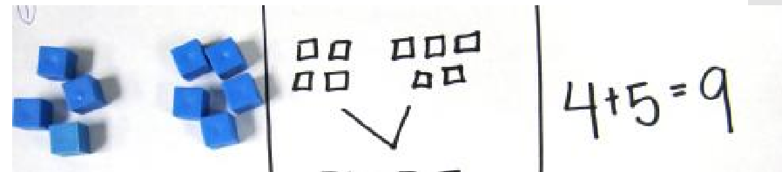
CPA approach
Concrete, pictorial, abstract (CPA) is a highly effective approach to teaching that develops a deep and sustainable understanding of maths. The CPA approach is the mainstay of maths teaching in Singapore.
doing seeing abstract

Slide 8

Types of understanding
Instrumental Understanding
“Instrumental understanding” can be thought of as knowing the rules and procedures without understanding why those rules or procedures work. Students who have been taught instrumentally can perform calculations, apply procedures… but do not necessarily understand the mathematics behind the rules or procedures.
Relational Understanding
“Relational understanding”, on the other hand, can be thought of as understanding how and why the rules and procedures work. Students who are taught relationally are more likely to remember the procedures because they have truly understood why they work, they are more likely to retain their understanding longer, more likely to connect new learning with previous learning, and they are less likely to make careless mistakes.
(Richard Skemp)
(rote and memorisation) vs (exploration and questioning)

Slide 9
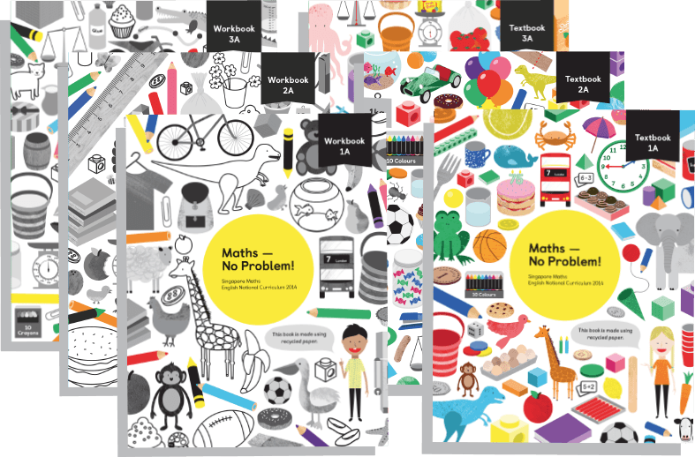
What is Maths – No Problem?
Maths — No Problem! is a series of textbooks and workbooks written to meet the requirements of the 2014 English national curriculum.
The MNP Primary Series was assessed by the DfE’s expert panel, which judged that it met the core criteria for a high-quality textbook to support teaching for mastery.
As a result, the MNP Primary Series are recommended textbooks for schools on the mastery programme.

Slide 10
Singapore approach to mathematics
Singapore established a new way of teaching maths following their poor performance in international league tables in the early 1980’s.
Based on recommendations from notable experts, Singapore maths is a combination of global ideas delivered as a highly-effective programme of teaching maths.
The effectiveness of this approach is demonstrated by Singapore’s position at the top of the international benchmarking studies and explains why their programme is now used in over 40 countries including the United Kingdom and the United States.

Slide 11
Singapore has become a “laboratory of maths teaching” by incorporating established international research into a highly effective teaching approach. With its emphasis on teaching pupils to solve problems, Singapore Maths teaching is the envy of the world.
Based on recommendations from notable experts such as Jerome Bruner, Richard Skemp, Jean Piaget, Lev Vygotsky, and Zoltan Deines, Singapore maths is an amalgamation of global ideas delivered as a highly-effective programme of teaching methods and resources.

Slide 12
One of highest performing countries in terms of maths
Teach the concepts of mathematics
Problem solving is at the heart of mathematics and should be the focus of what is taught in schools
The focus is not on rote procedures, rote memorisation or tedious calculation but on relational understanding
Pupils learn to think mathematically as opposed to reciting formulas they don’t understand
Is a way of teaching that allows students to develop a greater sense of number and how to use and manipulate numbers to solve a variety of problems
A highly effective approach to teaching maths based on research and evidence
Pupils are encouraged to solve problems working with their core competencies, in particular:
Visualisation
Generalisation
Make decisions

Slide 13
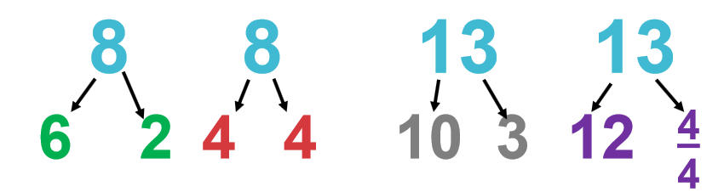
Number sense
Number sense is knowing what numbers mean by themselves and in relation to one another, the ability to partition (break apart numbers) into a variety of ways, and being able to manipulate numbers for different purposes.

Slide 14

What is mastery?

Slide 15
Mastery of Mathematics
Achievable for all
Deep and sustainable learning
The ability to build on something that has already been sufficiently mastered
The ability to reason about a concept and make connections
Conceptual and procedural fluency
Involves a longer time spent on key topics, providing time to go deeper and embed learning.
Procedure has to be backed up by understanding

Slide 16
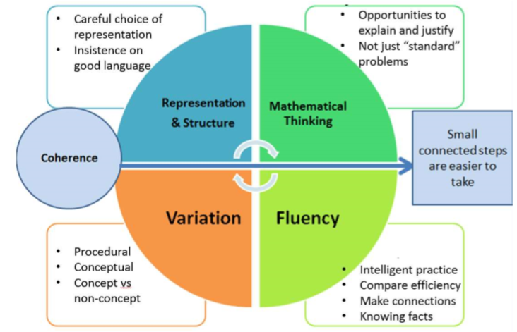
Five Big Ideas
Lesson design for Teaching for Mastery

Slide 17
Mastery
Involves a development or three forms of knowledge:
Factual – I know that
Procedural – I know how
Conceptual – I know why

Slide 18
We are aiming to provide children with opportunities to develop:
Deep and sustainable understanding of mathematical concepts
Ability to reason about mathematics and make connections
Facts and efficient procedures – the mathematical ‘tool kit’
Confidence and competence in using mathematics to solve problems

Slide 19
Structure of Maths – No Problem!
Concepts merge from one chapter to the next e.g.
Chapter 1 – Place Value
Chapter 2 – Addition and Subtraction
Each chapter has a series of lessons to follow
Children master topics before moving on

Slide 20
How lessons are taught
The parts to the lesson are:
Anchor task –entire class work on problem to solve, use of talk partners and teacher/ TA guiding. The children are encouraged during this time to think of as many ways as possible to solve the problem and explain their ideas.
Let’s Learn – look at methods from the text book together. Explain the method to your partner. What can we learn from this method?
Guided practice – practice new ideas with talk partners. Teachers/TAs assess understanding and support where needed.
Independent practice – mostly independent, teacher/teaching assistant work with guided groups or specific children identified from guided practice. Once children have mastered the concept they use their reasoning and problem solving skills to develop their depth of learning.

Slide 21
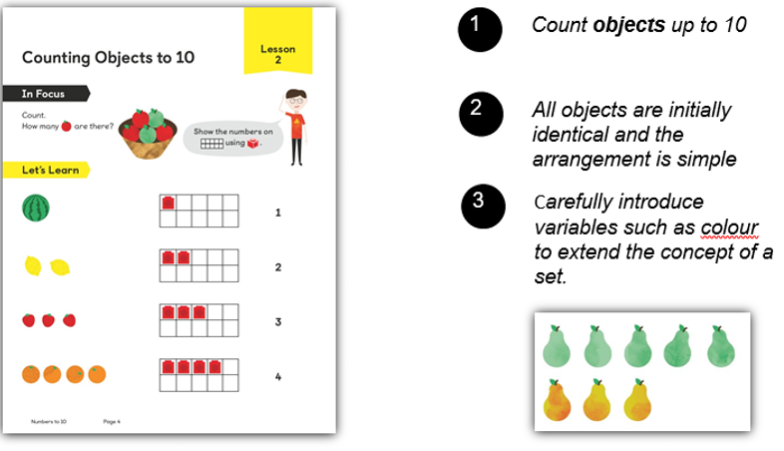

Slide 22
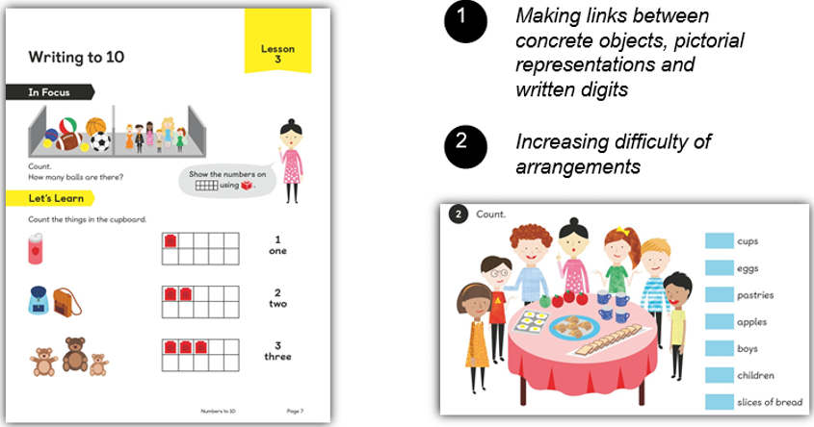

Slide 23
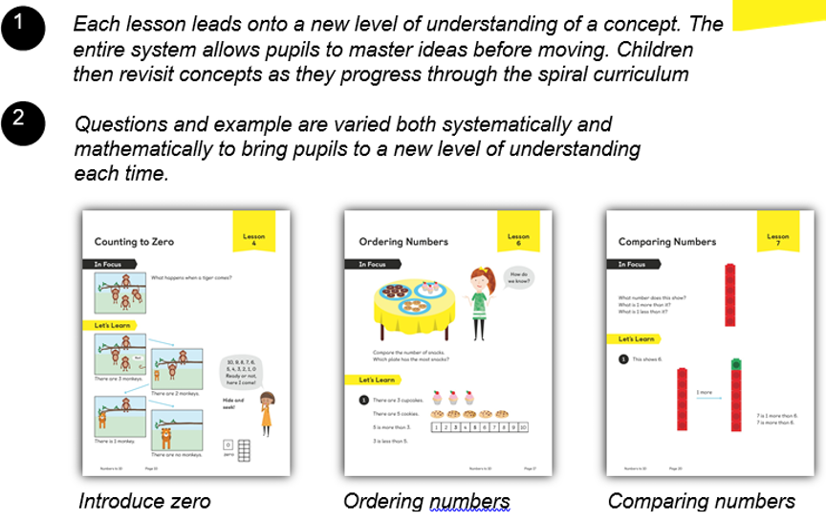

Slide 24
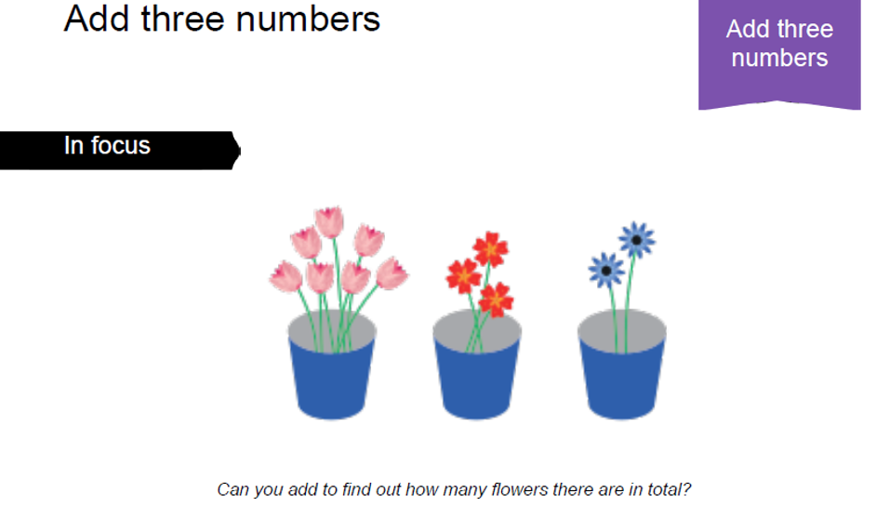
In Focus/ anchor task

Slide 25
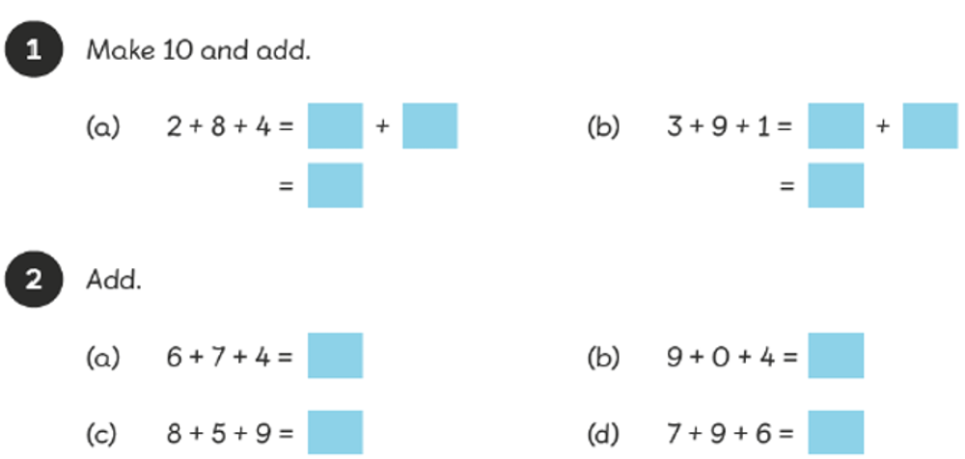
Guided practice

Slide 26
Textbooks
Ideas are developed systematically using learning theories and research as a basis, in particular, the work of Jerome Bruner (representations and spiral curriculum) and Zoltan Dienes (Informal-structured-practice progression as well as systematic and mathematical variation of examples)
Singapore spent a decade researching which questions to ask and in what order. The textbooks are based on this research.

Slide 27
Workbooks
Allow children to show their understanding of a concept by solving problems displayed in different ways
The questions are set up to ensure children understand the concept forwards, backwards and inside out
For rapid graspers this consolidates any previous learning before they move onto greater depth challenges
Children can work at their own pace through the questions

Slide 28
Maths journals
In focus
Guided practice
Challenges

Slide 29
How will children be challenged?
Make links between previous learning
Think about problems in different ways
Have opportunities to explain their reasoning
Find and explain generalisations
Use rich mathematical language when explaining ideas
Solve complex problems which expand on their mathematical knowledge
Work with a range of manipulatives to consolidate their understanding
Work with a mix of children in groups, pairs and independently

Slide 30
Challenge
Problem solving/ reasoning challenges
Explain using drawing/ equipment
Explain orally/ through writing
Write their own problem
Invent a method/ game
Create their own question
Make connections
Identify rules/ generalisations
Correct a mistake
Odd one out
Find something new

Slide 31
How are children supported?
Make links between previous learning
Think about the way they know to solve problems
Have opportunities to listen to mathematical vocabulary from peers and use themselves
Be given more time to work on tricky concepts
Work with a range of manipulatives to solve problems practically
Work with a range of children in groups, pairs and independently
Scaffold learning- extra clues and support

Slide 32
How teachers support all learners
Move individual children on at their own pace throughout the lesson
Set rich and sophisticated problem solving activities for rapid graspers
Give time for all children to fully grasp and master concepts
Provide visual stimuli for children to access a problem using CPA approach
Give children ownership in their learning
Model making mistakes- maths is challenging

Slide 33
“Negative ideas that prevail about maths… come from one idea, which is very strong, permeates many societies and is at the root of maths failure and underachievement: that only some people can be good at maths. The single belief – that maths is a ‘gift’ that some people have and others don’t – is responsible for much of the widespread maths failure in the world.”
Jo Boaler
Mathematical Mindset (2016)
Maths is challenging. Children need to expect to struggle - this is part of learning

Slide 34
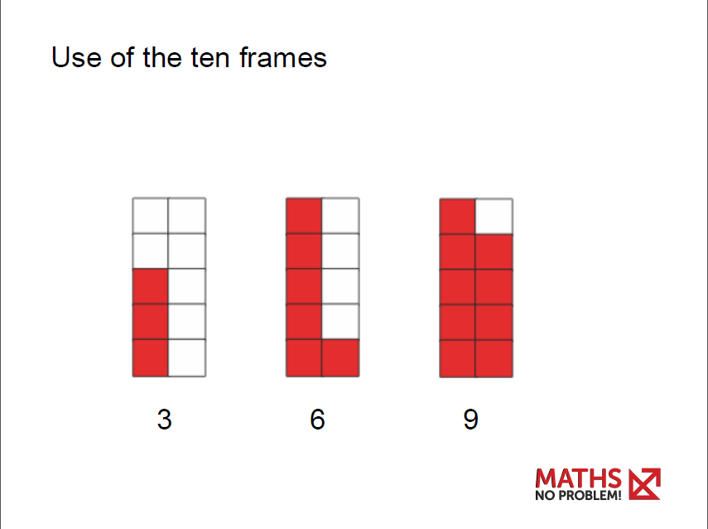
Notes:
Demonstrate with egg boxes
10 frames appear early in Year 1 and are a pictorial model of to represent numbers up to 10

Slide 35
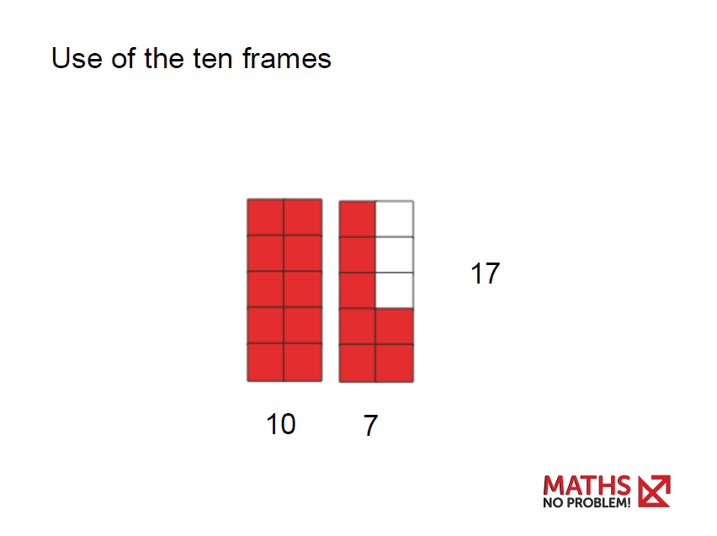
Notes:
The ten frame reappears later when children start counting to 20 – It is used to help pupils recognise that 10 ones can be renamed to 1 ten, introducing the concept of place value.

Slide 36
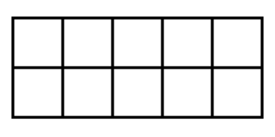
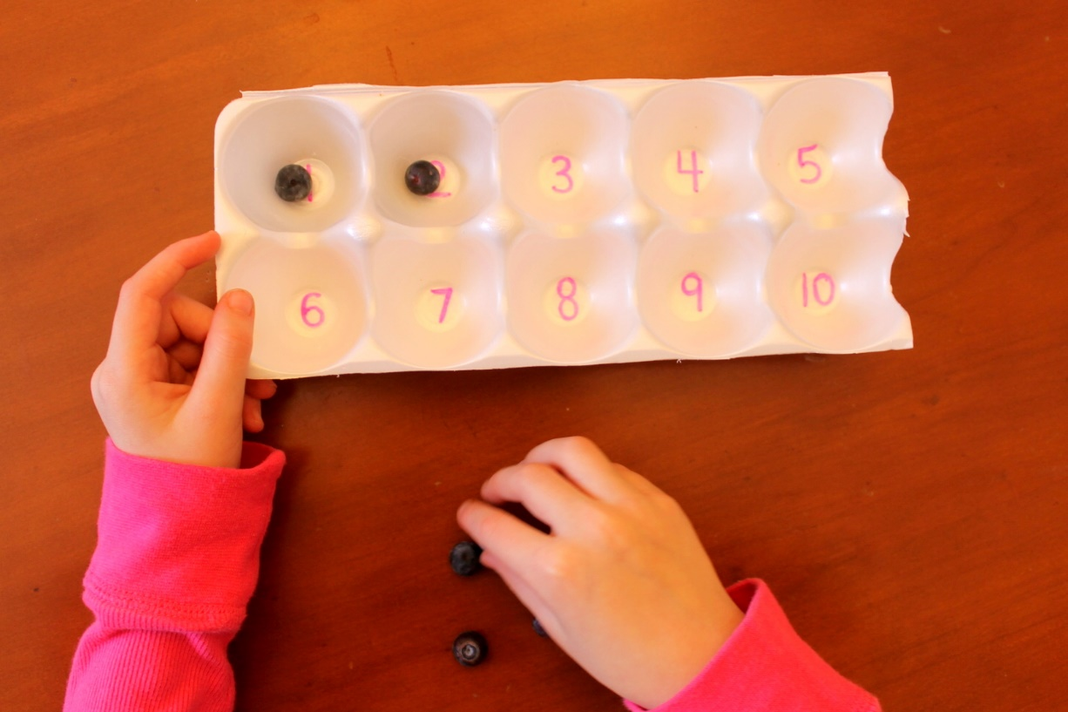
How to teach number bonds
How To Teach Number Bonds? | Maths – No Problem!
https://www.youtube.com/watch?v=D1hwopQLeCU

Slide 37

Parent videos
https://mathsnoproblem.com/en/parent-videos/ - 8 videos (3-6 mins long)
Dr Yeap Ban Har

Slide 38
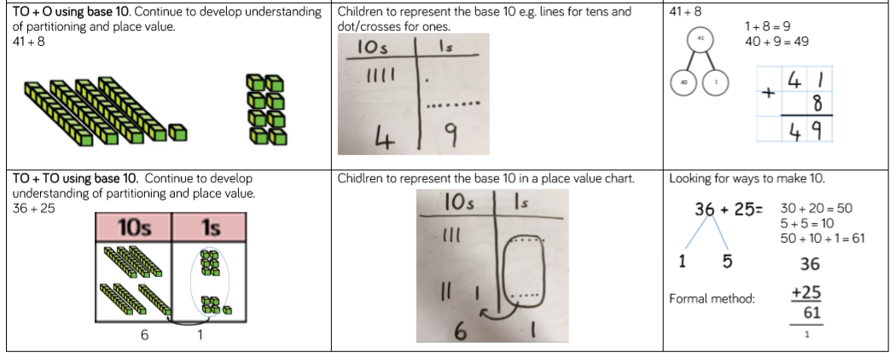
Column addition with regrouping

Slide 39
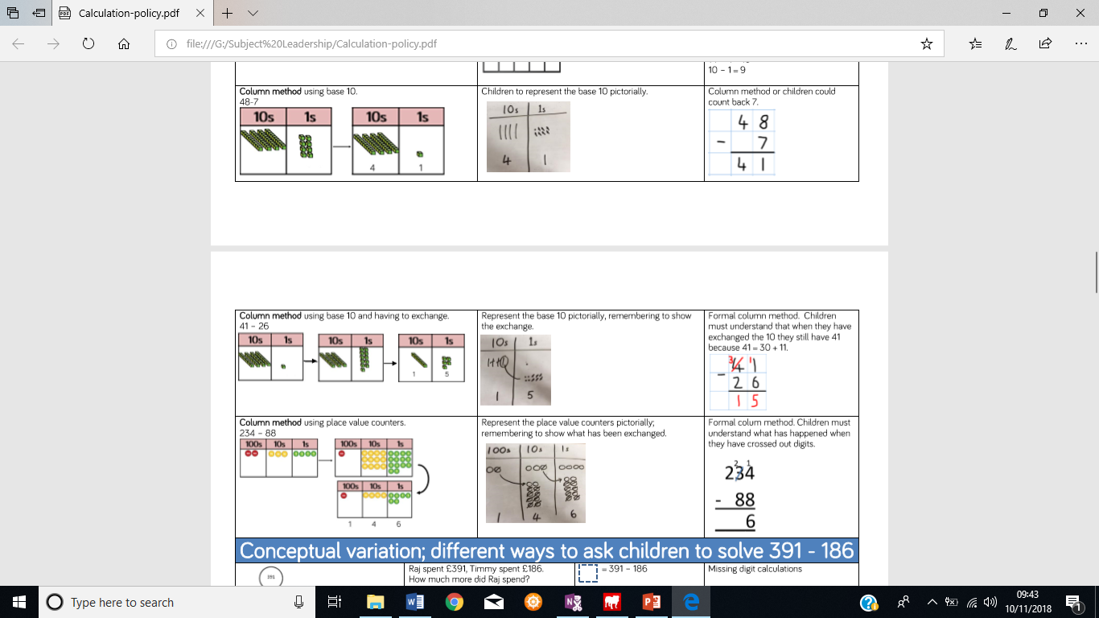
Column subtraction with regrouping

Slide 40

What the children think
I like it. It’s easier because I can see the maths in the textbooks.
It is really helping me with my maths.
I like it because it’s fun.
I love maths now because it’s much easier than before.
I like maths because it challenges me.
I enjoy it because I am learning tricky maths.
It is tricky but it’s fun.
I love Maths – No Problem because I find out new methods to use that makes maths easier. It’s cool.
I like that I get to work with a partner.

